Slide 1


Seng 477 Term Project
202028017 Ayhan Tan Acar
202028018 Ferhan Burak Özkan
202028013 Furkan Arslan
202128008 Osman Emre Kaya

Slide 2
SQL vs NoSQL
NoSQL (often interpreted as Not only SQL) database
It provides a mechanism for storage and retrieval of data that is modeled in means other than the tabular relations used in relational databases.
SQL | NoSQL
Relational Database Management System (RDBMS) | Non-relational or distributed database system.
These databases have fixed or static or predefined schema | They have dynamic schema
These databases are best suited for complex queries | These databases are not so good for complex queries
Vertically Scalable | Horizontally scalable
Follows ACID property | Follows BASE property

Slide 3
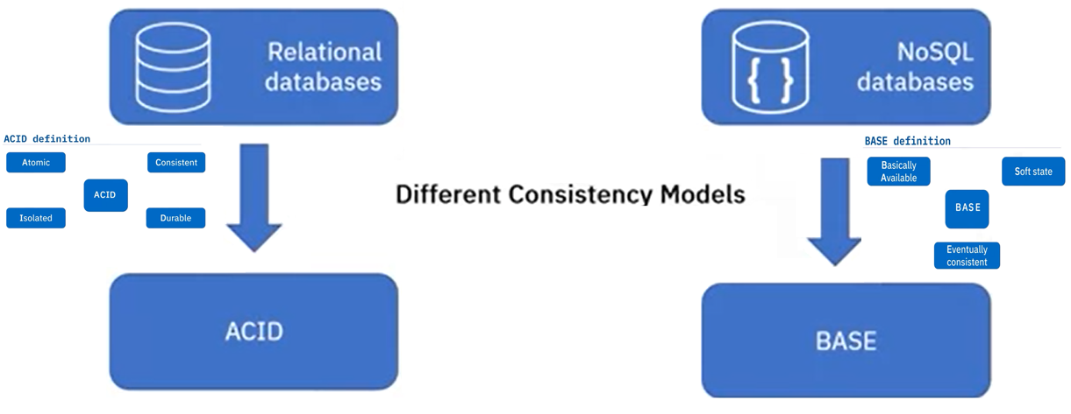
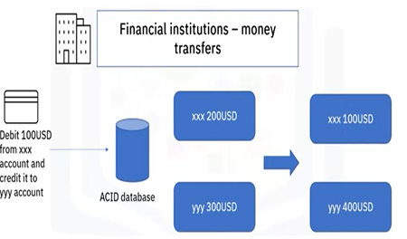
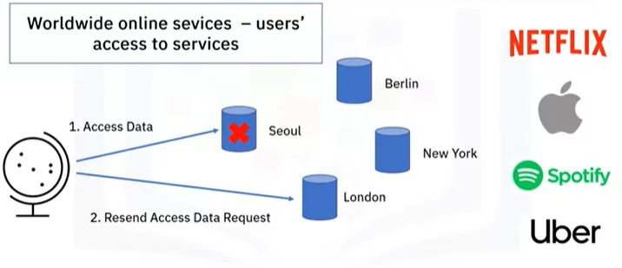

Slide 4

When to use NoSQL ?
When huge amount data needs to be stored.
The relationship between the data your store is not that important
The Data changes over time and is not structured.

Slide 5
What is MongoDB?
MongoDB is obviously a database
NoSQL
MongoDB is a document database with the scalability and flexibility that you want, and with the querying and indexing that you need.
Document based: MongoDB stores data in documents(data structures like JSON)
Scalable: Very easy to distribute data across multiple machines as your users and amont of data grows.
Flexible: No doc. Data schema req, so each doc. Can have diffrent numbers and typos of fields
Performant: Embedded data models, indexing, sharding, fixible doc., native duplication, Etc.
is a free and open-source database, published under the SSPL license.

Slide 6
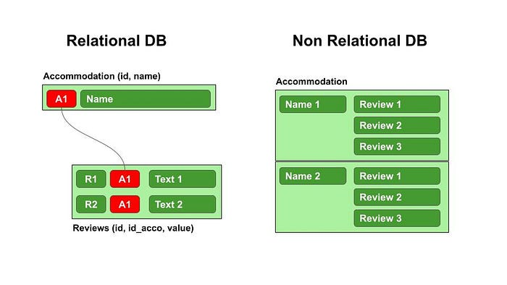
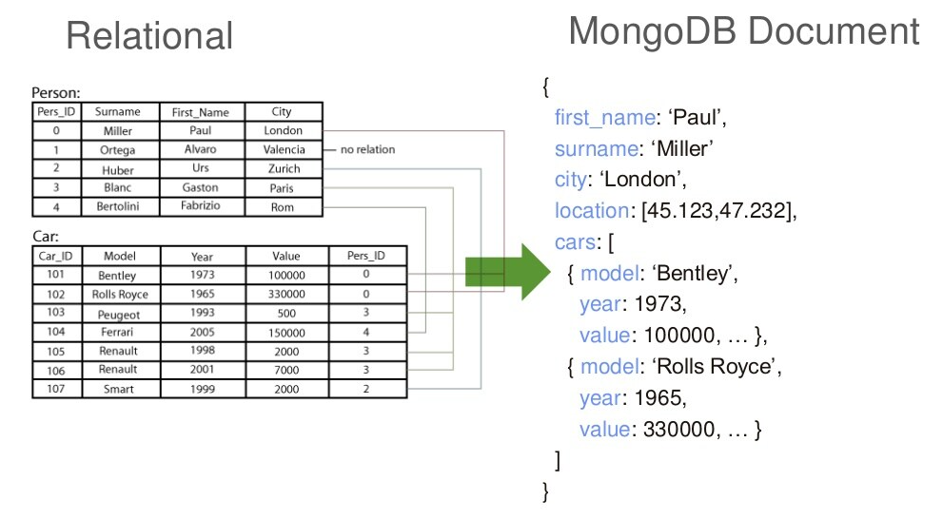
«And in fact, Mongo is probably the most used database with node JS»
BSON: Data format MongoDB uses for data storage. LİKE json, but typed

Slide 7
RDBMS vs MongoDB
MongoDB does not need any pre-defined data schema
Every document could have different data!
RDBMS |  | MongoDB
Database |  | Database
Table |  | Collection
Row |  | Document (JSON, BSON)
Column |  | Field
Index |  | Index
Join |  | Embedded Document
Partition |  | Shard

Slide 8
Features of MongoDB
Indexing: Efficient search and data processing in very little time.
Scalability: MongoDB scales horizontally using sharding, which involves partitioning data across various servers. Additionally, new machines can be added to a running database.
Replication & High Availability: Multiple copies of data are replicated on different servers, protecting the database from hardware failures. If one server goes down, data can be easily retrieved from other active servers that also store the data.
Load Balancing: MongoDB has automatic load balancing configuration due to data placement in shards.
Aggregation: Aggregation operations process data records and return computed results. It is akin to the GROUP BY clause in SQL. Some aggregation expressions include sum, avg, min, max, etc.
Languages Supported: MongoDB supports a variety of languages including Node.js, C, C++, C#, Go, Java, Perl, PHP, Python, Ruby, Rust, Scala, and Swift.

Slide 9
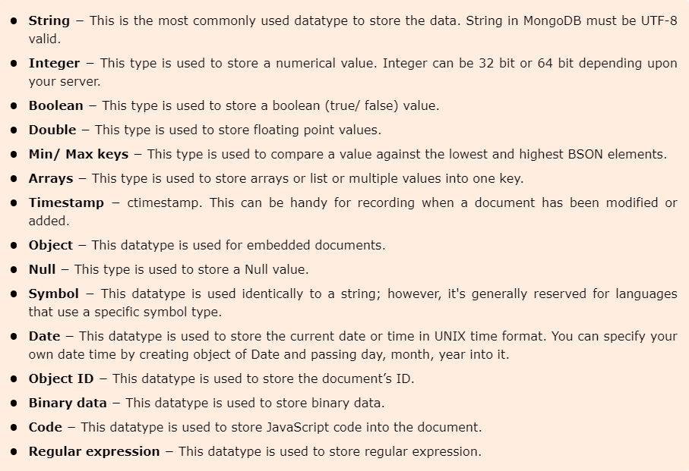
MongoDB Data Types

Slide 10
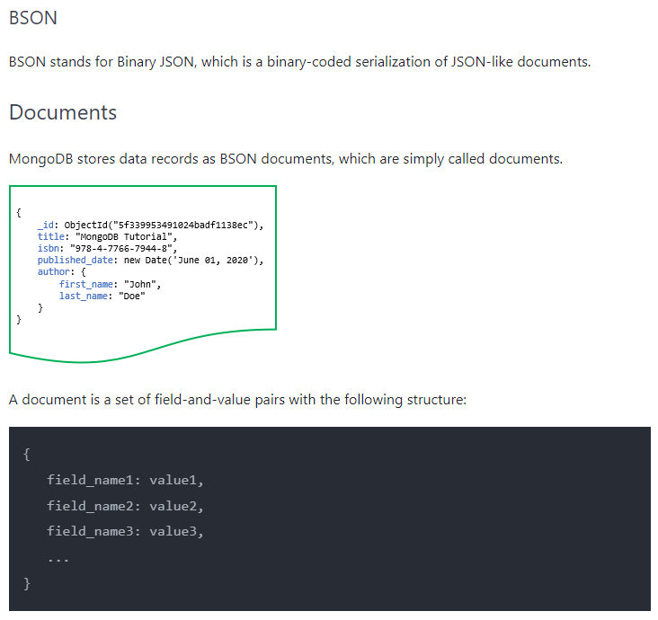
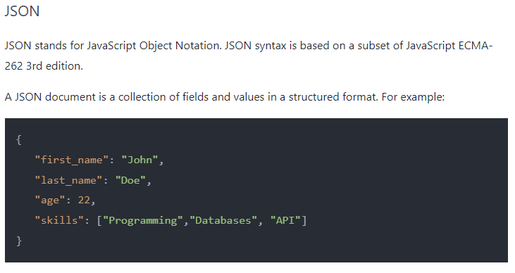

Slide 11
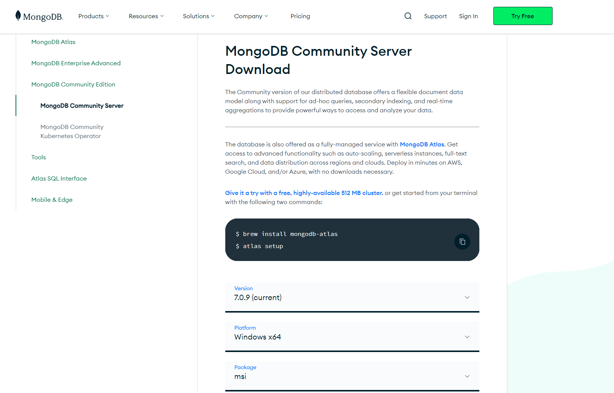
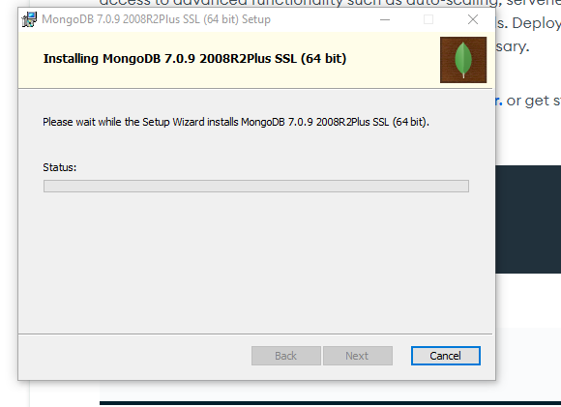
MongoDB Installation
MongoDB is available in two server editions: Community`Free` and Enterprise`Paid Version`.
Installation link: https://www.mongodb.com/products/platform/atlas-database

Slide 12
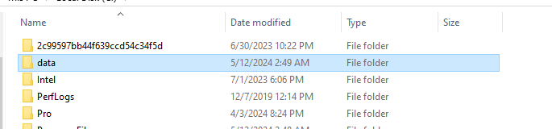
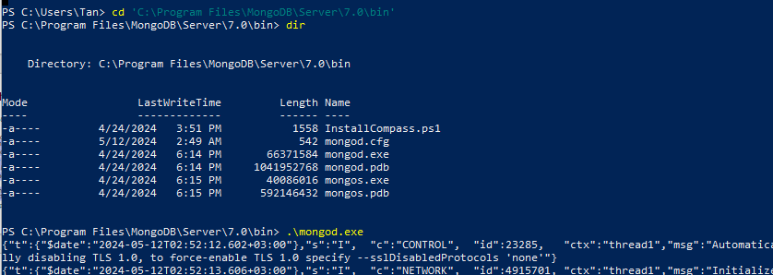
MonoDB will store our databases there

Slide 13
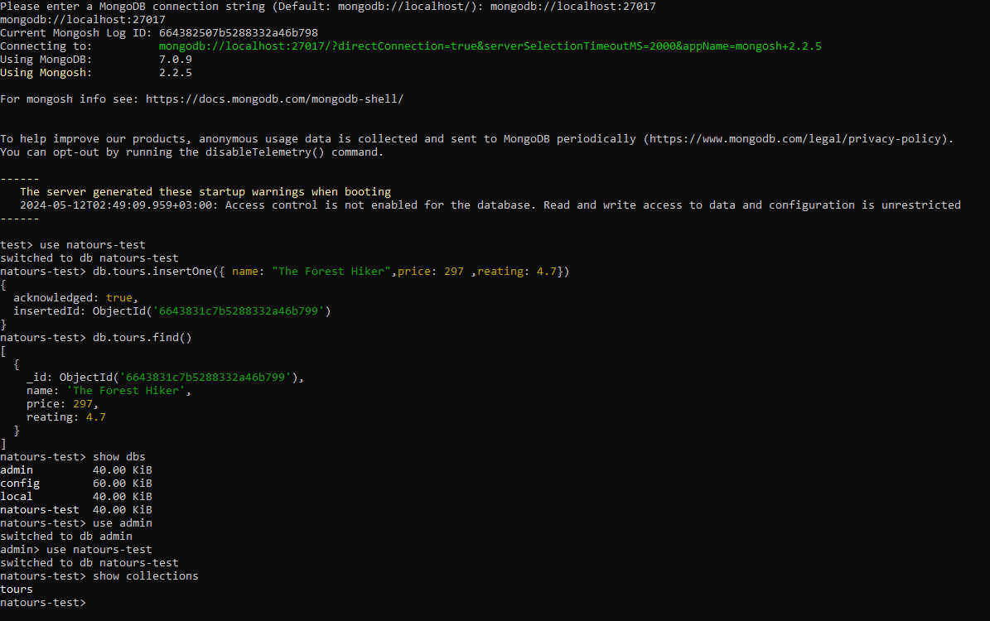
Create Local Database
The use Database_name command makes a new database in the system if it does not exist, if the db exists it uses that database
For example, use mydb. Now your db is ready to name mydb.

Slide 15
List All DB
To list all db, use the command below:
show dbs

Slide 16
Create Collection
There are 2 ways to create a collection.
You can create a collection using the createCollection() database method.
You can also create a collection during the insert process.

Slide 17
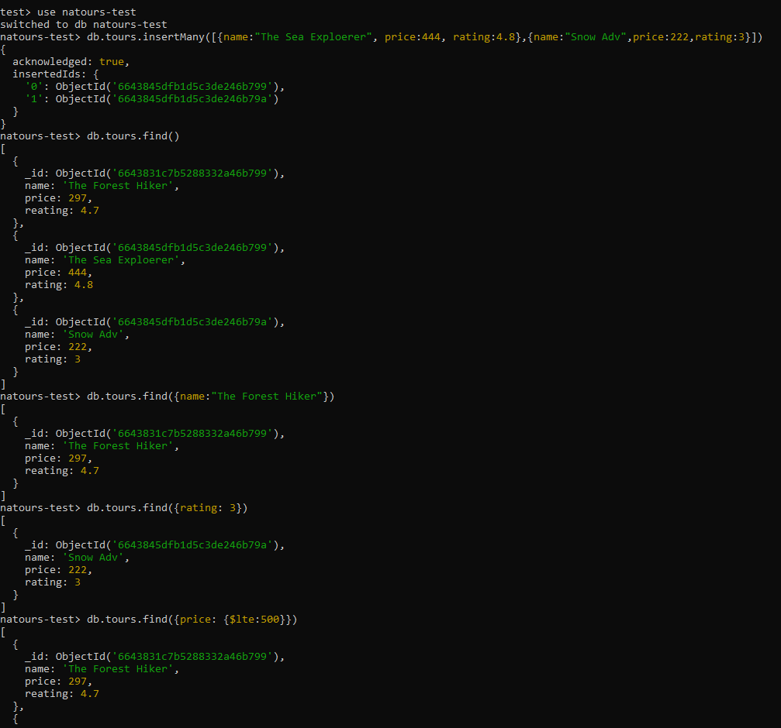

Slide 18
Find Data
To select data from a collection in MongoDB, we can use the find() method.

Slide 19
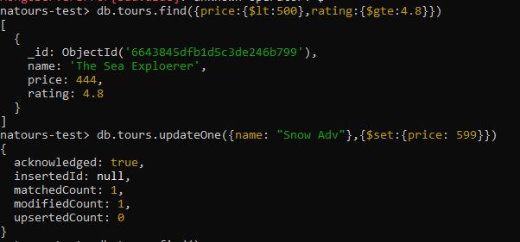
Update Document
To update an existing document we can use the updateOne() or updateMany() methods.
The first parameter is a query object to define which document or documents should be updated.
The second parameter is an object defining the updated data.

Slide 20
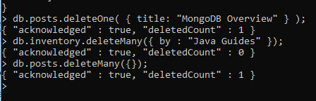
Delete Documents
We can delete documents by using the methods deleteOne() or deleteMany().

Slide 21
MongoDB Query Operators
There are many query operators that can be used to compare and reference document fields.
Comparison
$eq: Values are equal
$ne: Values are not equal
$gt: Value is greater than another value
$gte: Value is greater than or equal to another value
$lt: Value is less than another value
$lte: Value is less than or equal to another value
$in: Value is matched within an array
Logical
$and: Returns documents where both queries match
$or: Returns documents where either query matches
$nor: Returns documents where both queries fail to match
$not: Returns documents where the query does not match
Evaluation
$regex: Allows the use of regular expressions when evaluating field values
$text: Performs a text search
$where: Uses a JavaScript expression to match documents

Slide 22
MongoDB Update Operators
Fields
$currentDate: Sets the field value to the current date
$inc: Increments the field value
$rename: Renames the field
$set: Sets the value of a field
$unset: Removes the field from the document
Array
$addToSet: Adds distinct elements to an array
$pop: Removes the first or last element of an array
$pull: Removes all elements from an array that match the query
$push: Adds an element to an array

Slide 23
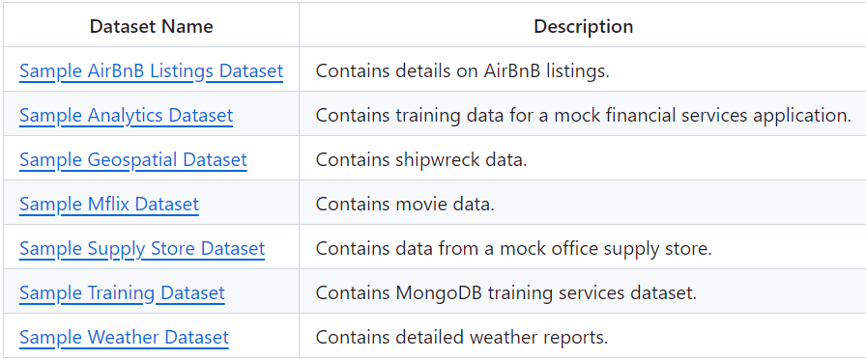
MongoDB Sample Databases
Atlas provides sample data you can load into your Atlas clusters. You can use this data to quickly get started experimenting with data in MongoDB.
MongoDB does not provide any sample databases on their website, however, they do provide sample databases for their cloud service Atlas. These databases have been dumped from a MongoDB Atlas cluster using the MongoDB Compass GUI.

Slide 24
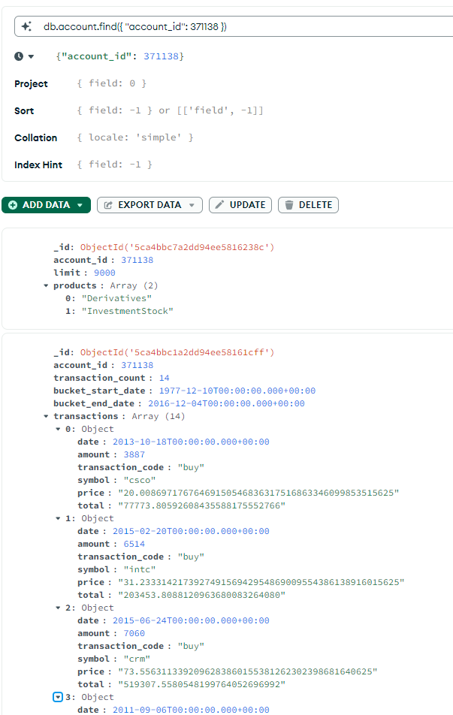
Using the Sample Analytics Dataset data set, it is observed what the user with account id 371138 does in the accounts, customers, transactions documents.

Slide 25
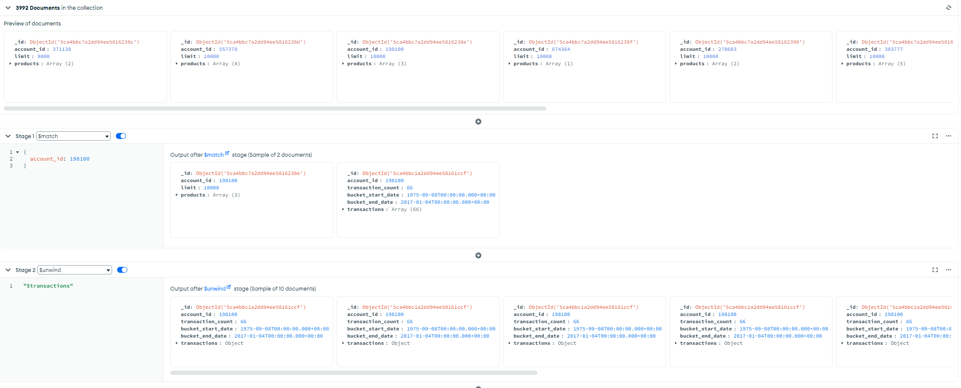
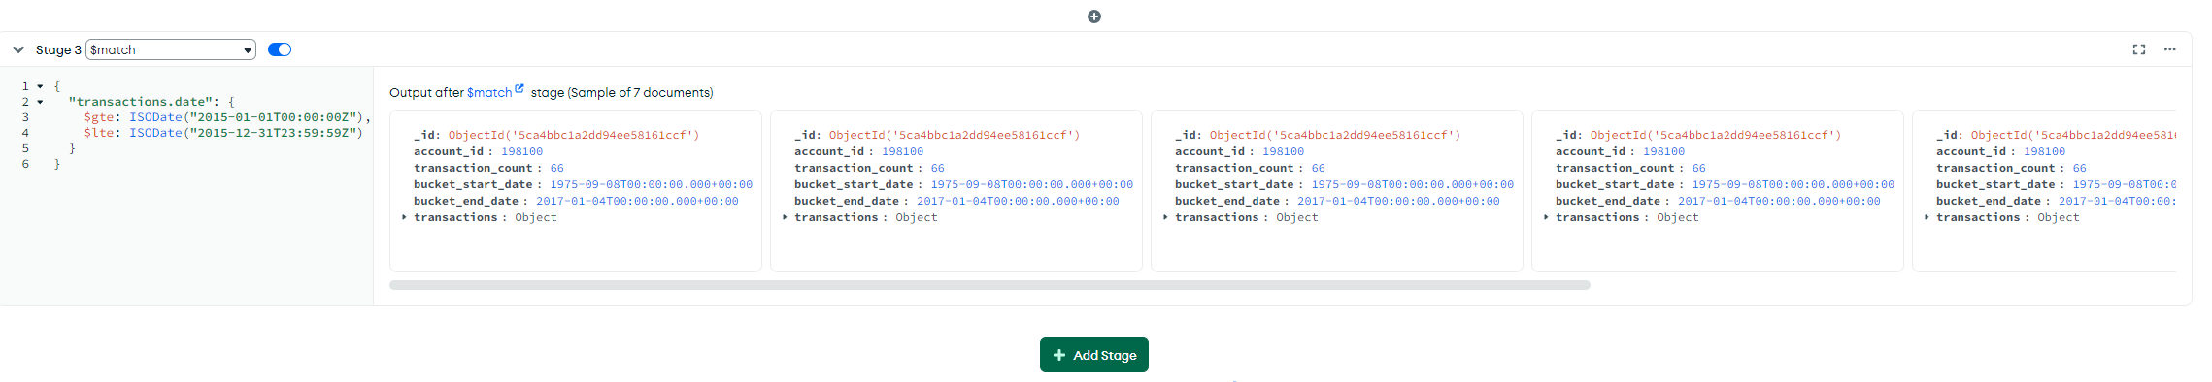

Slide 26
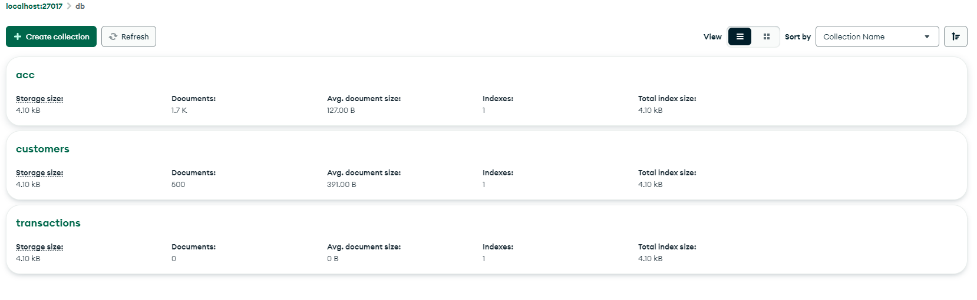
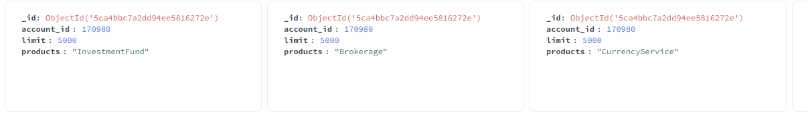
[
{
$match:
{
products: "Derivatives",
limit: {
$lte: 5000
}
}
},
{
$unwind: "$products"
}
]

Slide 27
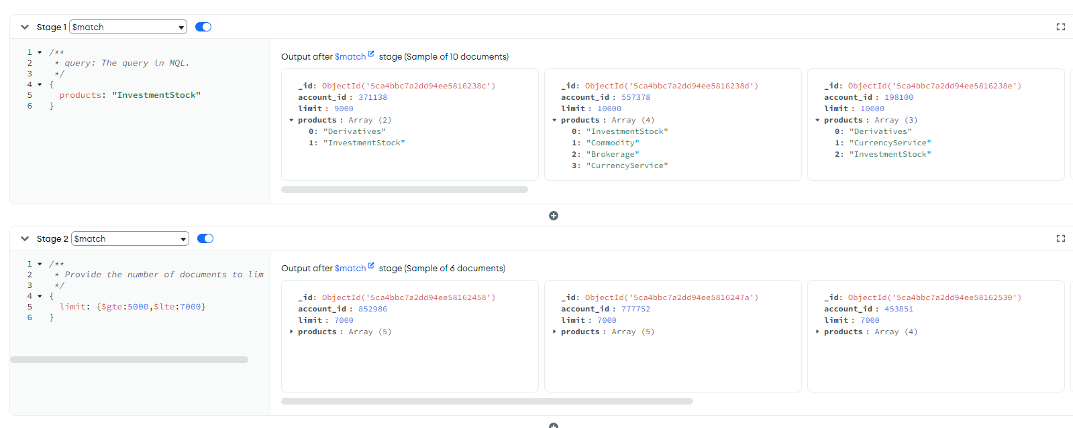
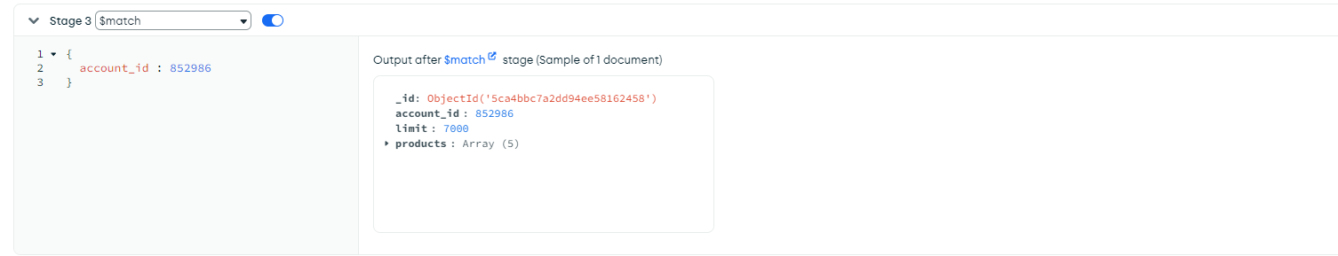

Slide 28
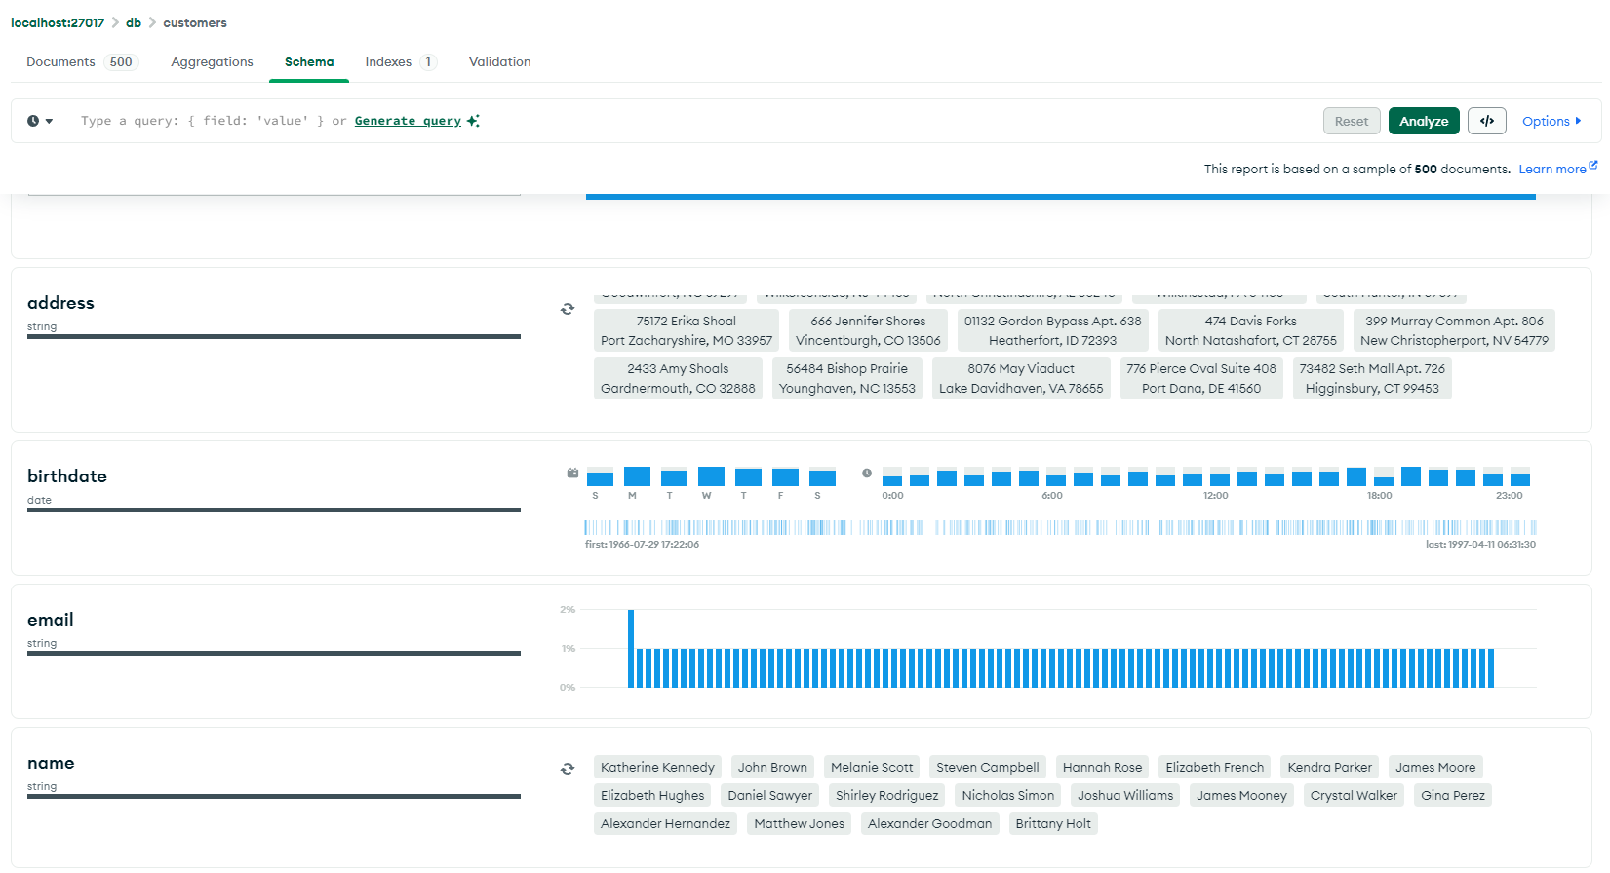
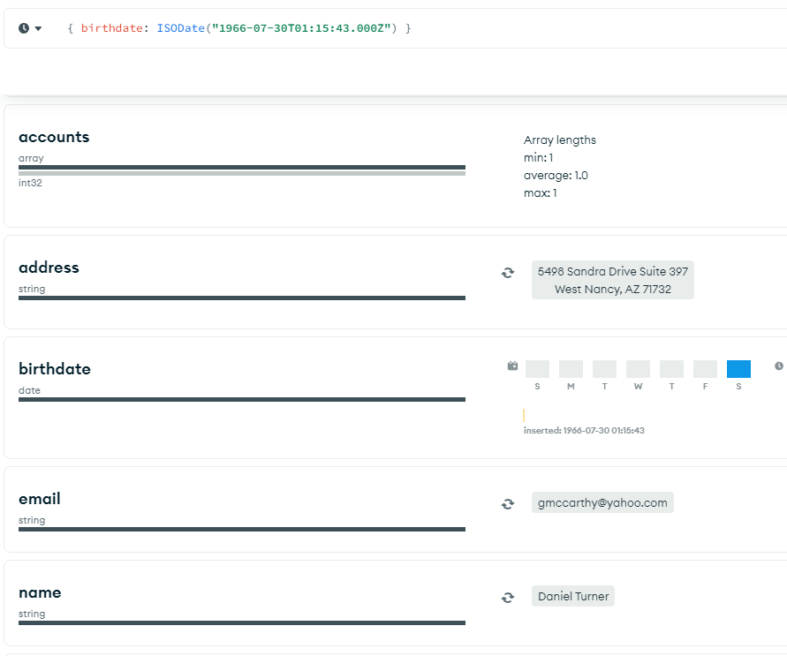

Slide 29
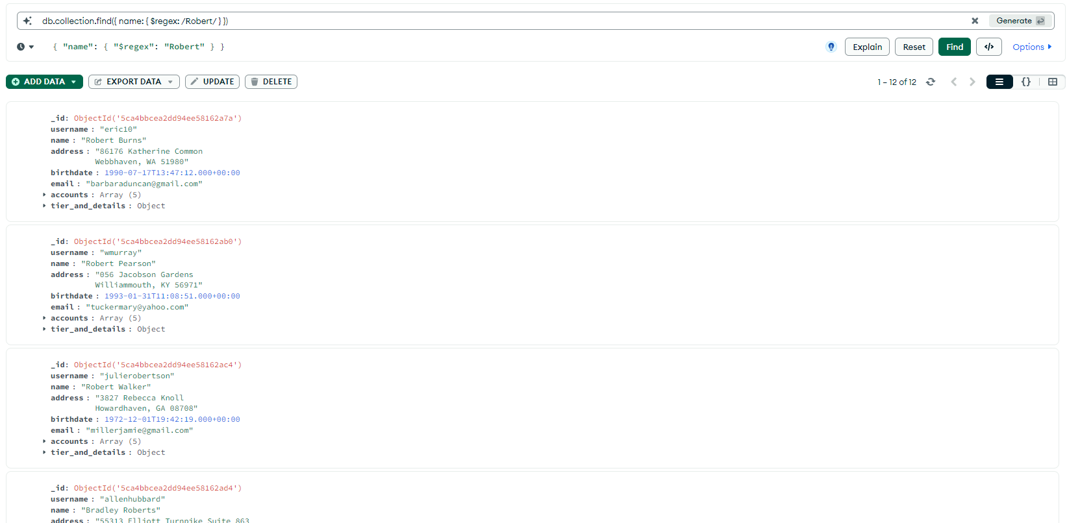

Slide 30
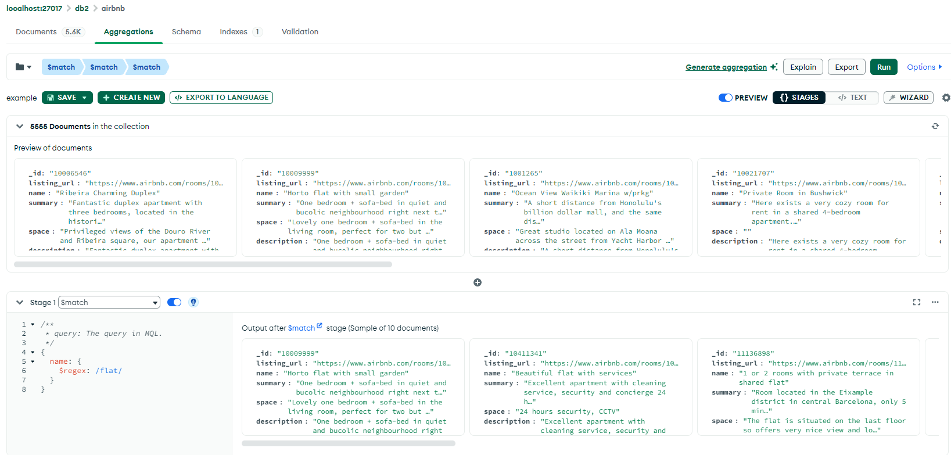
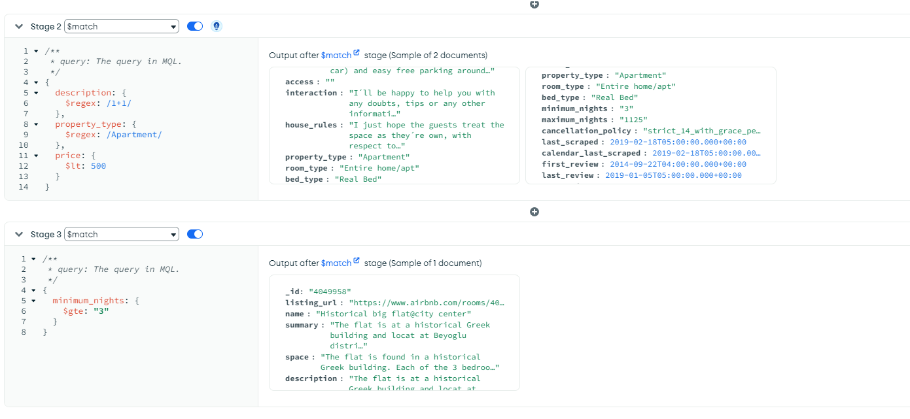

Slide 31
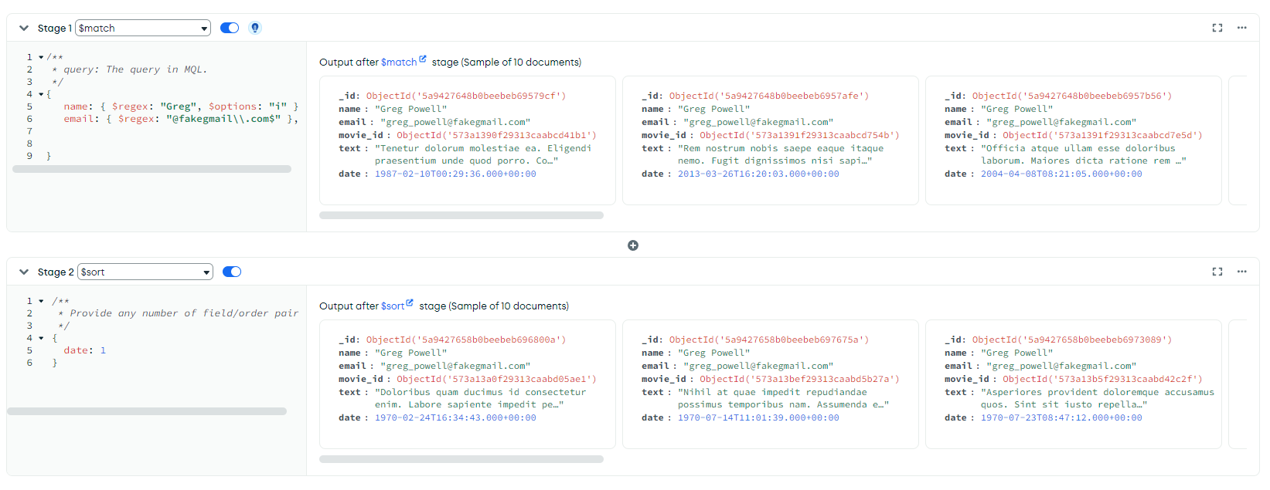
Find all users with the name "Greg".
Find all users with an email that includes "@fakegmail".
Sort these users by the date field.
db.reviews.find({name: { $regex: "Greg", $options: "i" }});
db.reviews.find({ email: /@fakegmail\.com$/ });
db.reviews.find({ email: /@fakegmail\.com$/ }).sort({ date: 1 });
[
{
$match:
{
name: {
$regex: "Greg",
$options: "i"
},
email: {
$regex: "@fakegmail\\.com$"
}
}
},
{
$sort:
{
date: 1
}
}
]

Slide 32
Reference
https://www.mongodb.com/
https://www.w3schools.com/mongodb/
https://www.youtube.com/watch?v=c2M-rlkkT5o&t=1796s
https://github.com/mongodb
https://www.mongodb.com/docs/atlas/tutorial/create-new-cluster/
https://docs.elastic.co/integrations/mongodb_atlas
https://www.mongodb.com/docs/atlas/sample-data/sample-airbnb/

